Slide 1


Slide 2
Integrating Quality Activities in
the Project Life Cycle
Software development methodologies:
- The software development life cycle (SDLC) model
- The prototyping model
- The spiral model
- The object-oriented model
Factors affecting intensity of SQA activities
Verification, validation and qualification
Development and quality plans for small and for internal projects
A model for SQA defect removal effectiveness and cost

Slide 3
INTRODUCTION
➔ We will start off talking about (in some cases reviewing) popular development models
Will switch to discussion how SQA activities are handled within the development process, and
Factors that need to be considered before applying these activities…
So, why this approach?

Slide 4
INTRODUCTION
Why discuss the models?
Answer: They represent the framework of a disciplined approach to development.
  Have milestones, deliverables, constraints, etc.
SQA must take place in conjunction with the completing of these activities or looking at the work products produced from these activities.
Need to understand the models before we can produce plans that are integrated into these models.

Slide 5
1. CLASSIC AND OTHER SOFTWARE DEVELOPMENT METHODOLOGIES
Will discuss
  The Software Development Life Cycle (SDLC)
  The prototyping model
  The spiral model
  The OO model

Slide 6
THE SDLC
The ‘classic mode.’
  Still in WIDE use today.
  Captures the major building blocks in development
  Linear sequence
  Highly structured; plan-driven; Heavy-weight process
  Product delivered for evaluation and deployment at the end of development and testing
  Big bang approach
  Used for major projects of length
  But serves as a framework for other models…

Slide 7
PROTOTYPING MODEL
Replaces some of the parts of the SDLC with an evolutionary and iterative process.
Software prototypes are repeatedly provided to customer for evaluation and feedback.
  Primarily iterate design and implementation.
  Development team provided requirements.
Ultimately, the product reaches a satisfactory completion.
Then, the remainder of the process is carried out in the context of another model, such as SDLC

Slide 8
SPIRAL MODEL
Uses an iterative approach designed to address each phases in development by obtaining customer comments and change, risk analysis, and resolution.
The spiral model typically has a ‘spiral’ for each of the traditional development phases.
Within a cycle, specific engineering (design, development, etc.) can take place using any other models, like SDLC, prototyping,..
The Spiral Model (Barry Boehm) is a risk-centered development model where each spiral includes major risk activities / assessments.
Was developed after SDLC in response to delayed risk in SDLC
As the SDLC, it is considered a heavy-weight, plan-driven methodology and is highly structured.

Slide 9
THE OBJECT-ORIENTED MODEL
Emphasis here is re-usability via reusable objects and components.
Component-based software development.
For non-available components, developer may
  prototype needed modules,
  use an SDLC approach,
  purchase libraries of objects,
  develop ‘his’ own, etc.

Slide 10
NOW, IN A BIT MORE DETAIL…

Slide 11
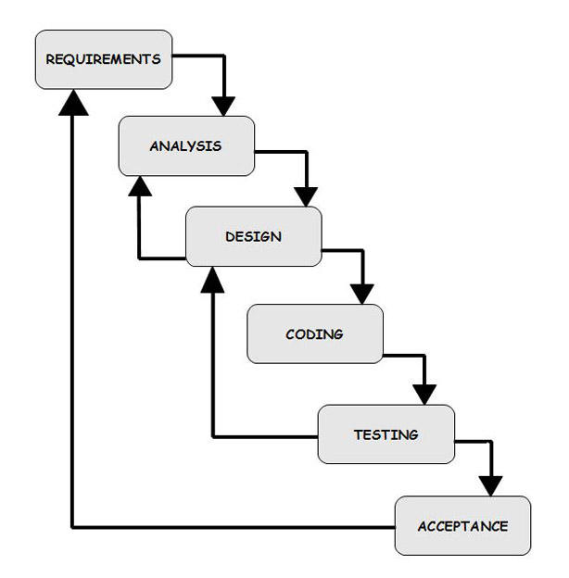
THE SDLC
Requirements Definition: done by customers
Analysis: analyze requirements to form an initial software model
Design: Detailed definition of inputs/outputs and processes including data structures, software structure, etc.

Slide 12
THE SDLC
Coding: Design translated into code.
  Coding includes SQA activities such as inspections, unit tests and integration tests
  Many takeoffs from this: These tests done by developers: individual (unit), group or team (integration tests….)

Slide 13
THE SDLC
System Tests: Goal: to discover errors / correct errors to achieve an acceptable level of quality. Carried out by developers prior to delivery.
Sometimes ‘acceptance tests’ carried out by customer or in conjunction with developer

Slide 14
THE SDLC
Installation / Conversion:
  After testing, system is installed and/or replaces an existing system;
  Requires software / data conversion
  Important to not interrupt daily activities during conversion process.
Install incrementally, run in parallel; turn switch and live with it, etc.

Slide 15
THE SDLC
Operations and Maintenance:
  Hopefully done for years.
  Maintenance:
    Corrective
    Adaptive
    Perfective
Lots of variations to the classic SDLC many in response to problems….
Notice the feedback loops?

Slide 16
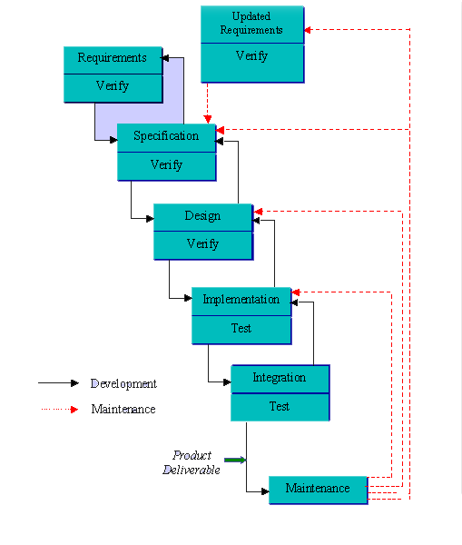

Slide 17
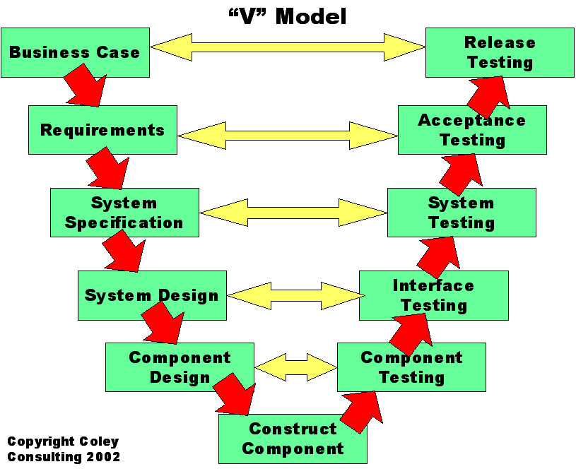

Slide 18
THE PROTOTYPING MODEL
One main idea behind prototyping is for the development of fast prototypes and customer availability for feedback.
Often prototyping tools are used to help
Developers respond to feedback and add additional parts as application evolves into an acceptable product.
Recognize this process can be inserted into the SDLC or other models.

Slide 19
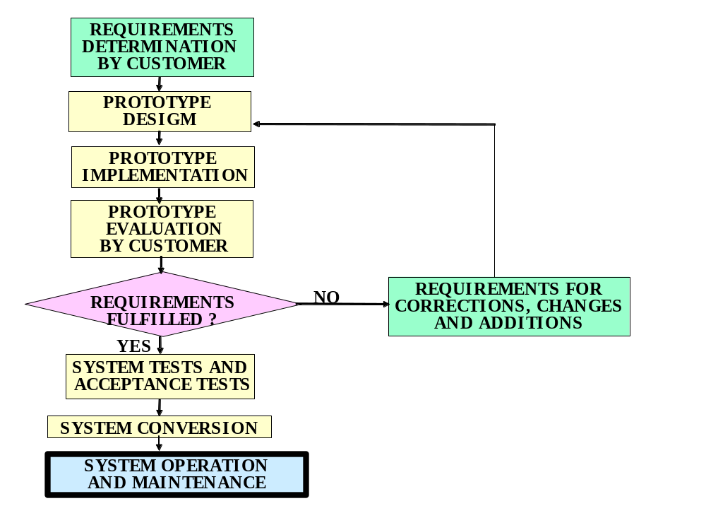
The prototyping model
A good approach for small to
medium-sized projects.
Very important: customer involvement.

Slide 20
PROTOTYPING MODEL - MORE
Advantages (book)
  Shorter development process
  Substantial savings in development resources (time)
  Better fit to customer requirements and reduced risk of project failure
  Easier and faster user comprehension of new system
Disadvantages
  Less flexibility and adaptability to changes and additions
  Reduced preparation for unexpected instances of failure

Slide 21
THE SPIRAL MODEL
A heavy-weight, plan-driven, highly-structured approach for large projects.
Especially designed for those with higher chances of failure.
Combines iterative model, emphasizes risk assessment, customer participation, prototyping, and more
Definitely an iterative process.

Slide 22
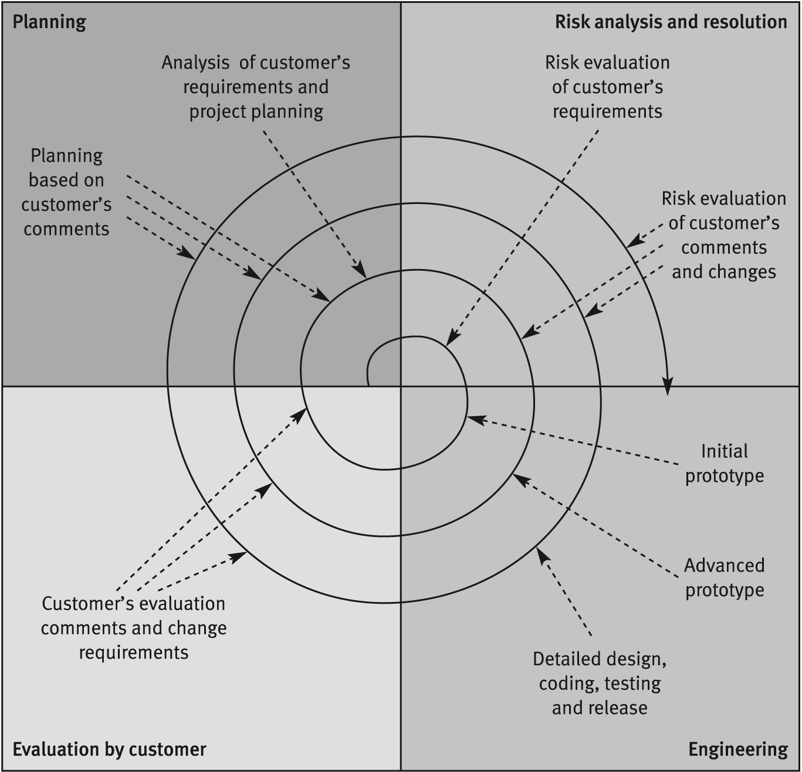
The Spiral Model
Can see each spiral
includes:
Planning
Risk Analysis / Resolution
Engineering activities
(design, code, test…)
Customer Evaluation
(errors, changes, new
requirements…)
Source: After Boehm 1988 (© 1988 IEEE)

Slide 23
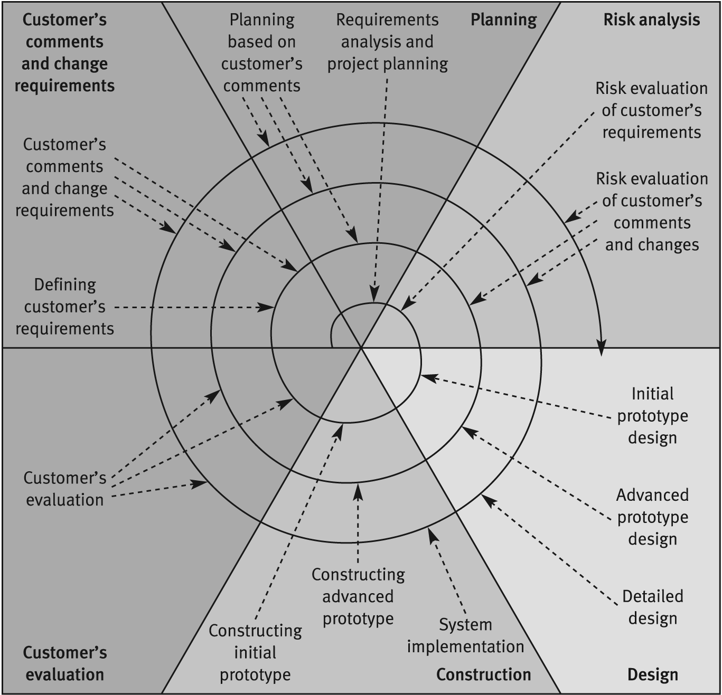
The Advanced
Spiral model The Win-Win Model
Revised Spiral Model provides
customer with improved chances
for changes;
developer better chances to stay
within budget and time.
Done by increased emphasis on
customer participation and
on engineering activities.
Extra sections in spiral
dedicated to customer actions
and developer engineering
Source: After Boehm 1998 (© 1988 IEEE)

Slide 24
THE OBJECT-ORIENTED MODEL
Easy integration of existing software modules (objects / components) into newly developed software systems.
Process begins with OOA and OOD
Then, acquire suitable components from reusable software component libraries (or purchase them).
Otherwise, develop as needed.
Can involve adding to repertoire of library components.
Economy: integrating reusable components; much lower cost than developing
Improved quality – using tested components
Shorter development times: integration of reusable software components.

Slide 25
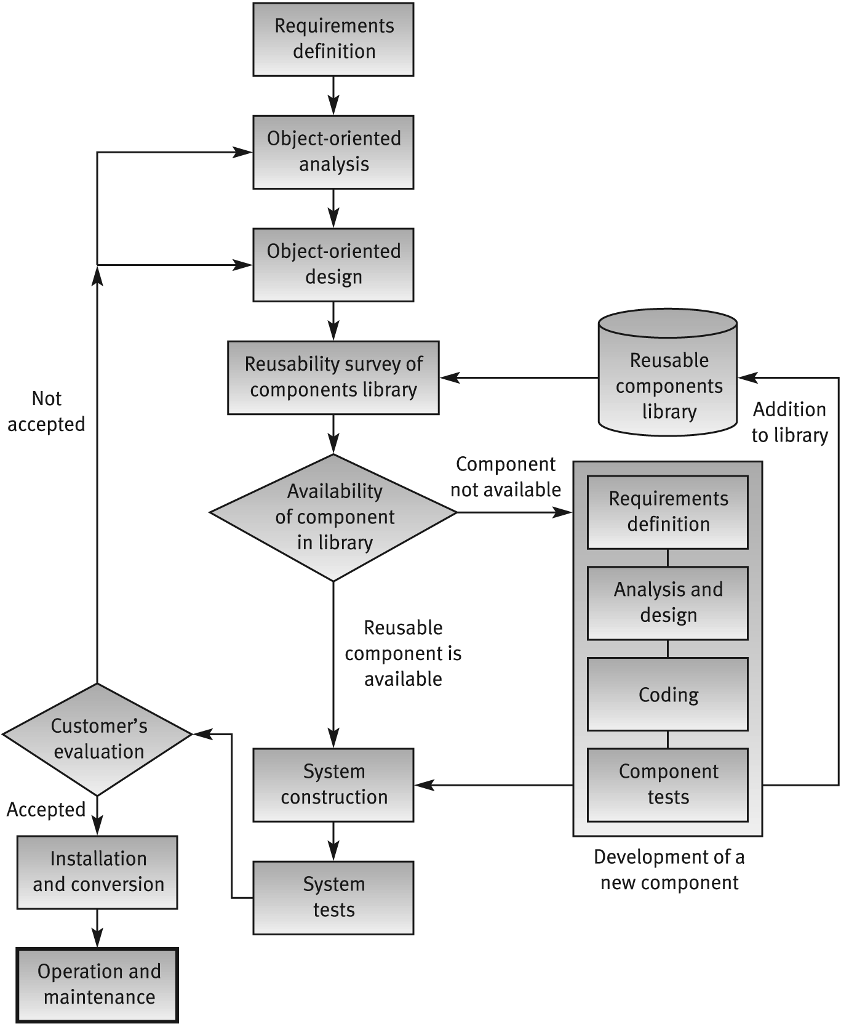
Object Oriented
Development Model

Slide 26
Now, onto
Factors Affecting the Intensity of Quality Assurance Activities within the Development Process…

